Slide 1


INTERNET OF THINGS
SMART HOME AUTOMATION
ADHARSHINI C(210701014)
AKSHAYA R(210701023)
ANANYA N(210701027)

Slide 2
INTRODUCTION
The Internet of Things (IoT) refers to the network of interconnected devices embedded with sensors, software, and other technologies that enable them to collect and exchange data over the internet. These devices can range from everyday objects like household appliances and wearable gadgets to industrial machinery and smart city infrastructure. The key characteristic of IoT devices is their ability to communicate with each other and with external systems, allowing for remote monitoring, control, and automation of various processes.
In the context of home automation, IoT enables the creation of smart homes where devices such as lights, thermostats, security cameras, and appliances are interconnected and can be controlled remotely via smartphones, tablets, or computers. This connectivity not only enhances convenience for users but also offers opportunities for energy efficiency, security, and personalized experiences tailored to individual preferences.

Slide 3
LITERATURE SURVEY
Paper: Design and development of NodeMCU-based automation home system using the internet of things
Author: SA Ajagbe, OA Adeaga, OO Alabi
Year: 2024
Disadvantage: While the system is described as low-cost, it may lack advanced features found in more expensive solutions.
Paper: Light Fidelity-based Home Automation System with NodeMCU
Author: MM Gwani, AM Gimba, MM Kunya
Year: 2024
Disadvantage: The system's reliance on light fidelity may limit its effectiveness in environments with poor lighting conditions.
Paper: Design and Construction of Voice Controlled Home Automation using NodeMCU
Author: UI Ibrahim, H Ohize, UA Umar
Year: 2024
Disadvantage: Voice-controlled systems may suffer from accuracy issues, particularly in noisy environments or with accents that the system may not recognize.

Slide 4
LITERATURE SURVEY
Paper: An Internet of Things-Integrated Home Automation with Smart Security System
Author: M Sayeduzzaman, T Hasan
Year: 2024
Disadvantage: Integration challenges in IoT-based systems may lead to compatibility issues between devices and platforms.
Paper: Review and analysis of different automation techniques for household applications
Author: KS Rathore, A Raj, H Dixit, K Harsh
Year: 2024
Disadvantage: Some automation techniques may require manual intervention or setup, reducing their efficiency compared to fully automated systems.
Paper: Home Automation Using AI Tool
Author: G Vivek, MR Kumar, PAK Reddy, V Sekhar
Year: 2024
Disadvantage: The implementation of AI-based tools may introduce complexity and potential for errors in configuration and operation.

Slide 5
EXISTING SYSTEM
Existing home automation systems vary widely in complexity, features, and implementation. Some systems rely on microcontroller platforms like NodeMCU or Raspberry Pi, while others leverage IoT (Internet of Things) technology for connectivity and control. These systems typically consist of a combination of hardware devices, such as sensors, actuators, and microcontrollers, and software applications for user interaction and automation logic.
NodeMCU-based home automation systems offer flexibility and customization, allowing users to create tailored solutions for their specific needs. These systems often involve programming the NodeMCU board to interface with sensors and actuators, enabling tasks such as turning lights on/off, adjusting thermostat settings, or monitoring environmental conditions like temperature and humidity. While NodeMCU-based systems are relatively affordable and accessible, they may require some level of programming knowledge and technical skill to set up and customize.

Slide 6
PROPOSED SYSTEM
The proposed home automation system aims to address the limitations of existing solutions by offering a comprehensive, user-friendly, and affordable platform for controlling household devices remotely. Built upon the foundation of NodeMCU microcontroller and leveraging IoT principles, this system provides a versatile and accessible solution for users of varying technical expertise.
The core of the proposed system revolves around an NodeMCU microcontroller board, which serves as the central control hub for managing connected devices. NodeMCU's simplicity and versatility make it an ideal choice for this application, enabling users to easily interface with sensors, actuators, and other peripherals.

Slide 7
REQUIREMENTS
HARDWARE SPECIFICATION
NodeMCU ESP8266
Lithium Ion Battery
5V Double channel Relay module
Breadboard
SOFTWARE SPECIFICATION
Arduino IDE
Windows 11
Blynk Library
Blynk IOT

Slide 8
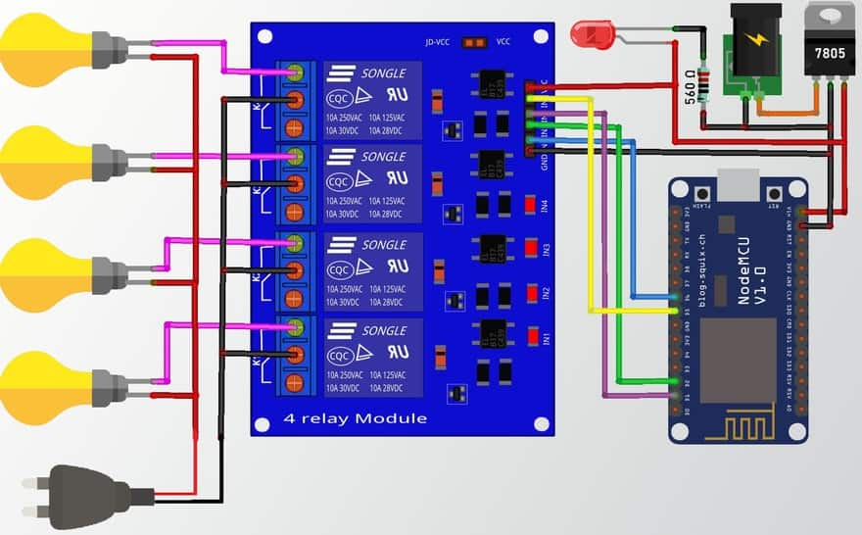
ARCHITECTURE DIAGRAM

Slide 9
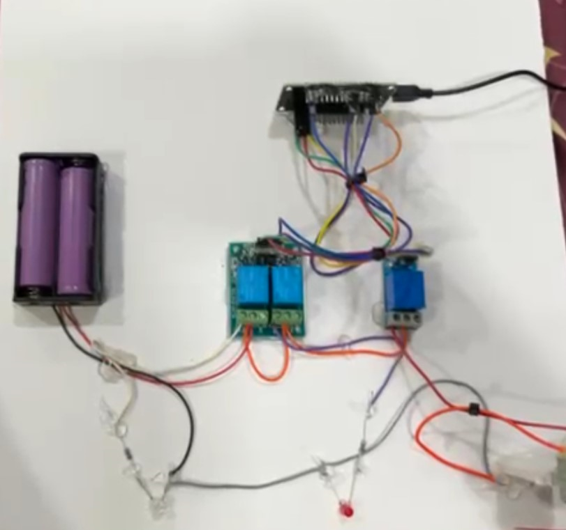
OUTPUTS

Slide 10
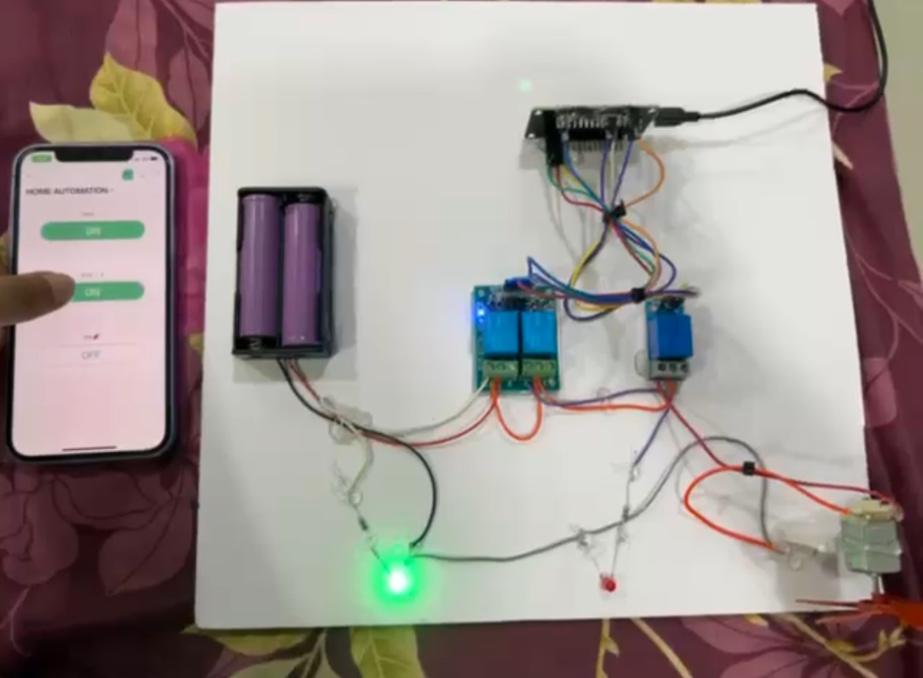
OUTPUTS

Slide 11
CONCLUSION
In conclusion, the home automation system represents a significant stride towards modernizing and enhancing residential living. Through the integration of cutting-edge technologies such as the NodeMCU microcontroller, relay modules, sensors, Bluetooth connectivity, and a dedicated mobile application, the system offers users unprecedented levels of convenience, efficiency, and control over their home environments. By enabling remote monitoring and management of household devices, it empowers users to streamline their daily routines, optimize energy usage, and enhance overall comfort and security.

Slide 12
FUTURE ENHANCEMENTS
Looking ahead, several promising directions for future work can further elevate the home automation system's capabilities and address emerging needs. Integration of artificial intelligence (AI) and machine learning (ML) algorithms stands out as a transformative avenue. By leveraging AI/ML, the system can evolve from reactive to proactive, anticipating user preferences and automating tasks based on learned patterns and predictive analytics. This could include personalized device scheduling, energy optimization algorithms, and adaptive behavior based on user habits and environmental factors.
Security remains paramount, and future work can focus on enhancing the system's resilience against cyber threats. This involves implementing advanced encryption methods, multifactor authentication, and anomaly detection to safeguard user data and prevent unauthorized access. Moreover, research into blockchain-based solutions could provide tamper-resistant data integrity and decentralized authentication mechanisms, further fortifying the system's security posture.

Slide 13
REFERENCES
Rush, A. M. (2015). A Neural Attention Model for Abstractive Sentence Summarization. arXiv preprint arXiv:1509.00685.
Vaswani, A., Shazeer, N., Parmar, N., Uszkoreit, J., Jones, L., Gomez, A. N., ... & Polosukhin, I. (2017). Attention is all you need. In Advances in neural information processing systems (pp. 30-38).
Nallapati, R., Zhou, B., Santos, C. N., Gulcehre, C., & Xiang, B. (2016). Abstractive text summarization using sequence-to-sequence RNNs and beyond. arXiv preprint arXiv:1602.06023.
Liu, P. J., Saleh, M., Pot, E., & Goodrich, B. (2019). Generating Wikipedia by Summarizing Long Sequences. arXiv preprint arXiv:1801.10198.

Slide 14
Thank You

